Slide 1
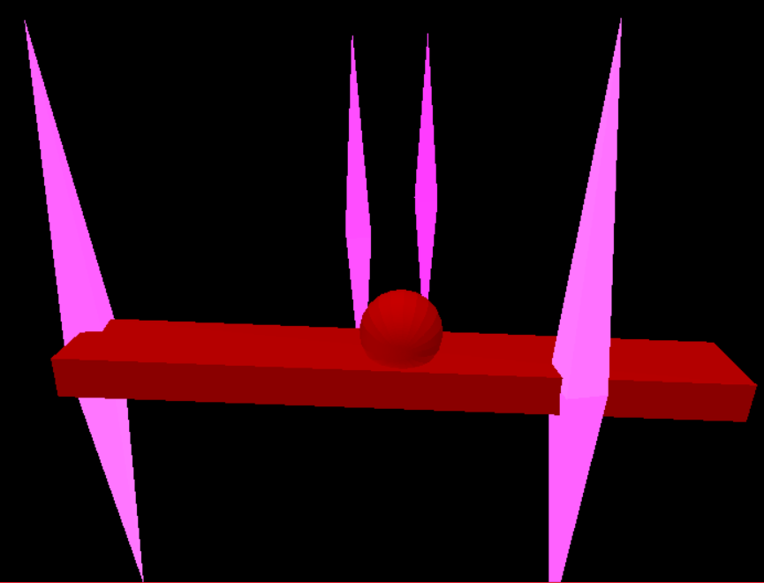
Roller Ball Minigame
Michael Del Rosario and David Zweig

Slide 2
What is Roller Ball?
Mini-game
Player controls a platform to roll the ball
Avoid obstacles and do not fall off to stay alive
Score is based on time alive
Additional optional functionality (Wii Remote)

Slide 3
Player Control
Obstacles
Other Additions

Slide 4

Player Control
On startup, main menu provides option to start the game
As the game plays, the player uses arrow keys to control a platform that tilts to affect the movement of a ball
The ball rotates on the platform as it moves, though max friction is assumed
Going off-platform results in a Game Over; to avoid this, ball must not go off the edge

Slide 5
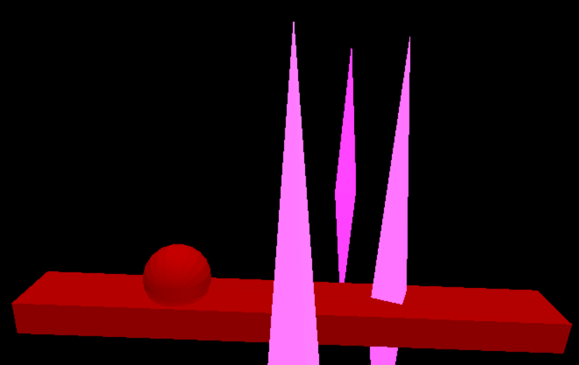
Obstacles
In the way of the ball are magenta, scaled-up, diamond-shaped pillar obstacles that rotate along local Y-axis and move towards the platform
Over time, new obstacles are placed ahead of the ball at a random X-position and move faster to make the game more difficult (albeit slowly)
Collision Check for each obstacle drawn:
Checks if it intersects the platform
Then get the distance between ball and obstacle
If distance between X coordinates is less or equal to the sum of their radii, Game Over!

Slide 6
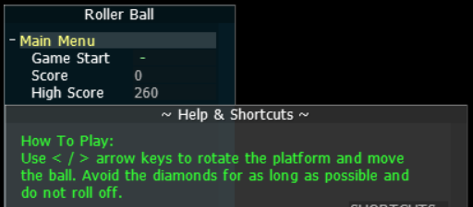

Other Additions
AntTweakBar and Scoring System
AntTweakBar provides for the title and results screen; includes a guide
Score fields are read-only and non-adjustable by the user
The longer the ball avoids collision or falling, the greater the score
Wii Remote Control
Would have been implemented as an optional control scheme; did not have enough time to implement it comfortably
BlueTooth connection and external libraries required to work
Wiimote motion-sensor tilt controls were to affect the platform rotation

Slide 7
Player Control
Obstacles
Other Additions

Slide 8
Project Analysis
Meeting Goals:
Basic Game complete
Missing additional obstacle type
Tilting Tower (Reverse Kinematics)
Missing Wii-mote functionality
New Results
The platform does not move forward as originally planned
To make up for this, the obstacles come toward the platform instead

